Slide 1
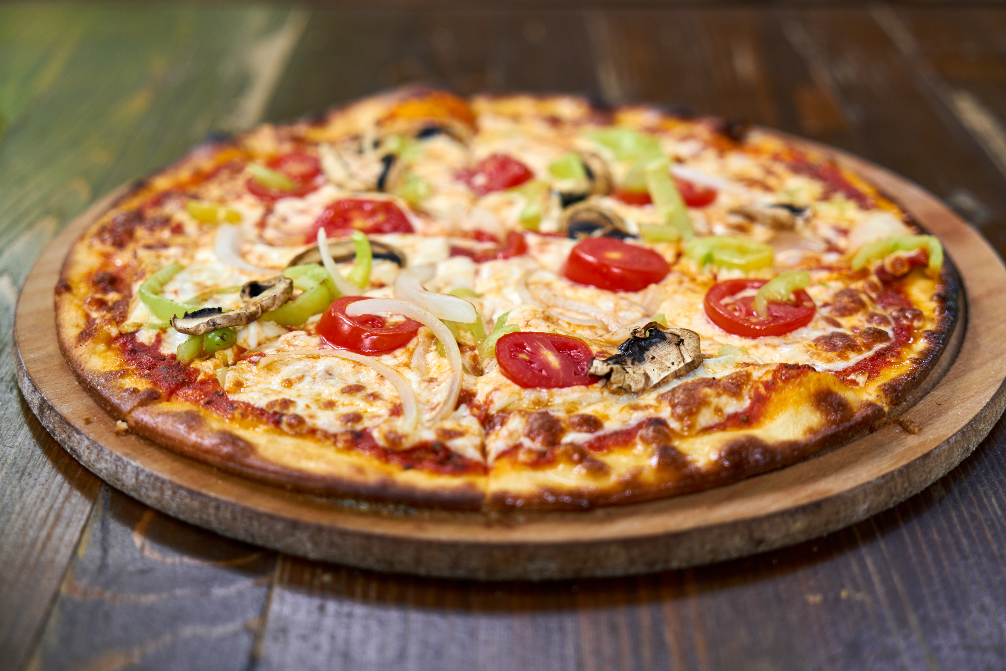
Pizza Sales Analysis
Analyzing pizza sales to identify trends, bestsellers, and peak hours using Excel
PRESENTED BY
ROHINI KODIDELA

Slide 2
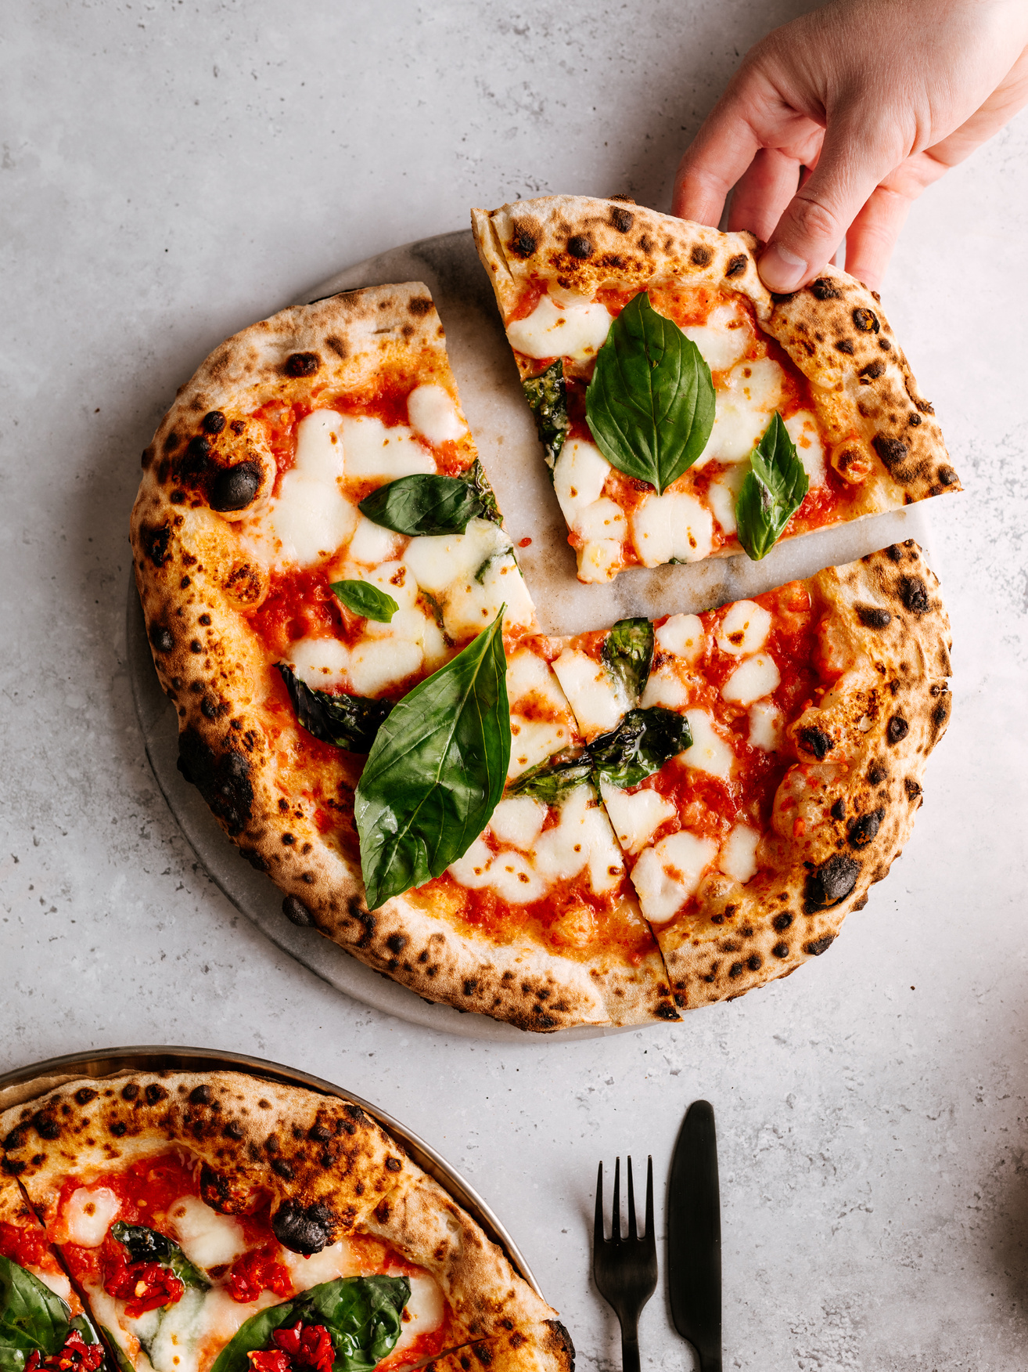
PROJECT OVERVIEW
Objective : To explore and visualize key sales patterns in a pizza restaurant to support data-driven business decisions.
Tools used : Microsoft Excel (Pivot Tables, Slicers, Line/Bar Charts)
Data Source: Pizza sales dataset with daily transactional data for the year 2015.
Duration Analyzed: Jan 1 – Dec 31, 2015
2

Slide 3
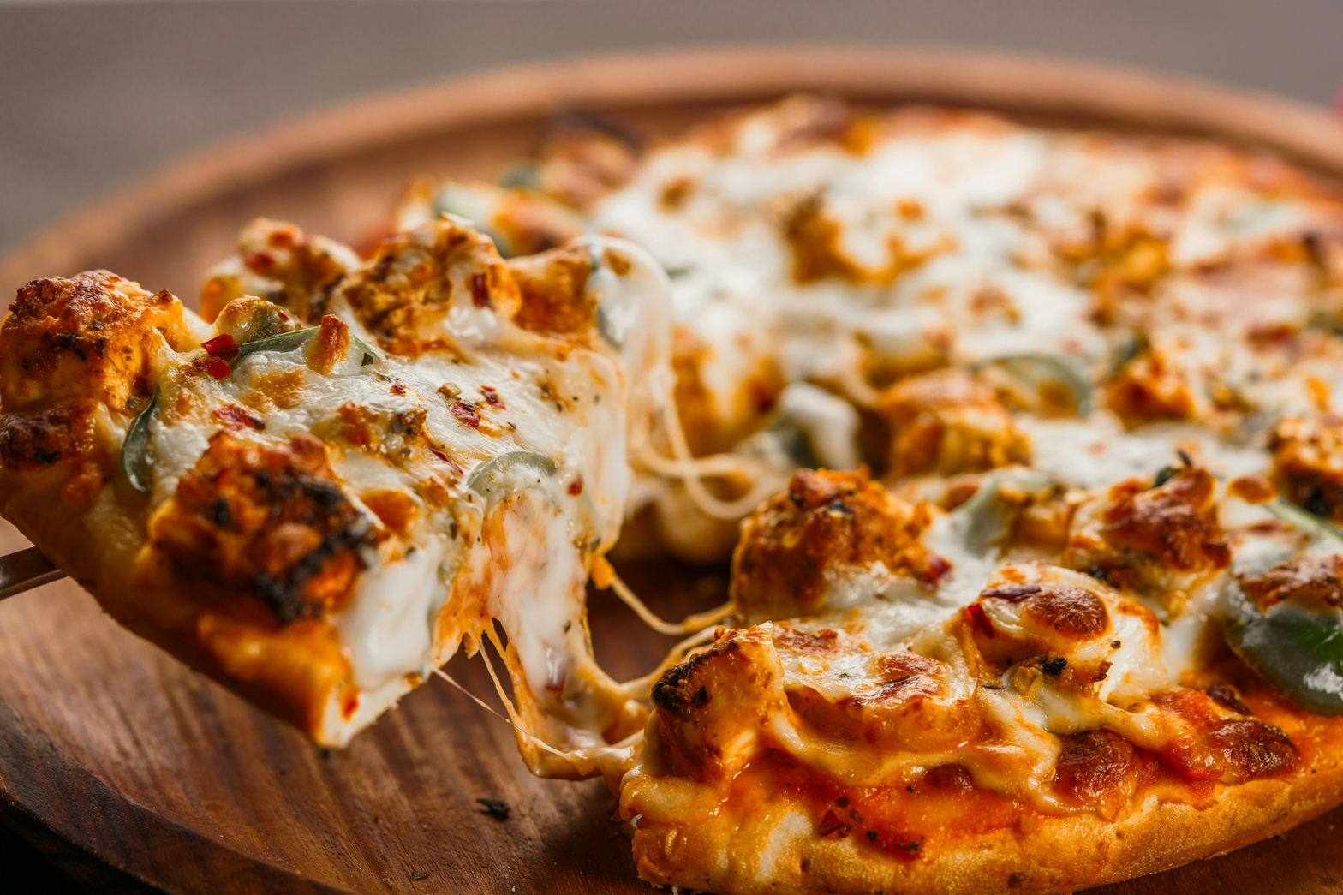
PROJECT GOALS AND KPI’S
Goals :
Understand sales trend across different time frames (hourly, weekly, monthly).
Identifying the top and bottom-performing pizzas by revenue and quantity.
Analyze category and size preferences to inform marketing and inventory decisions.
Reveal customer behaviour patterns using order time, day, and pizza types.
Key Performance Indicators to track our success:
Success will be measured using key KPIs such as customer retention, average order value, and monthly sales growth to ensure alignment with business goals.
3

Slide 4

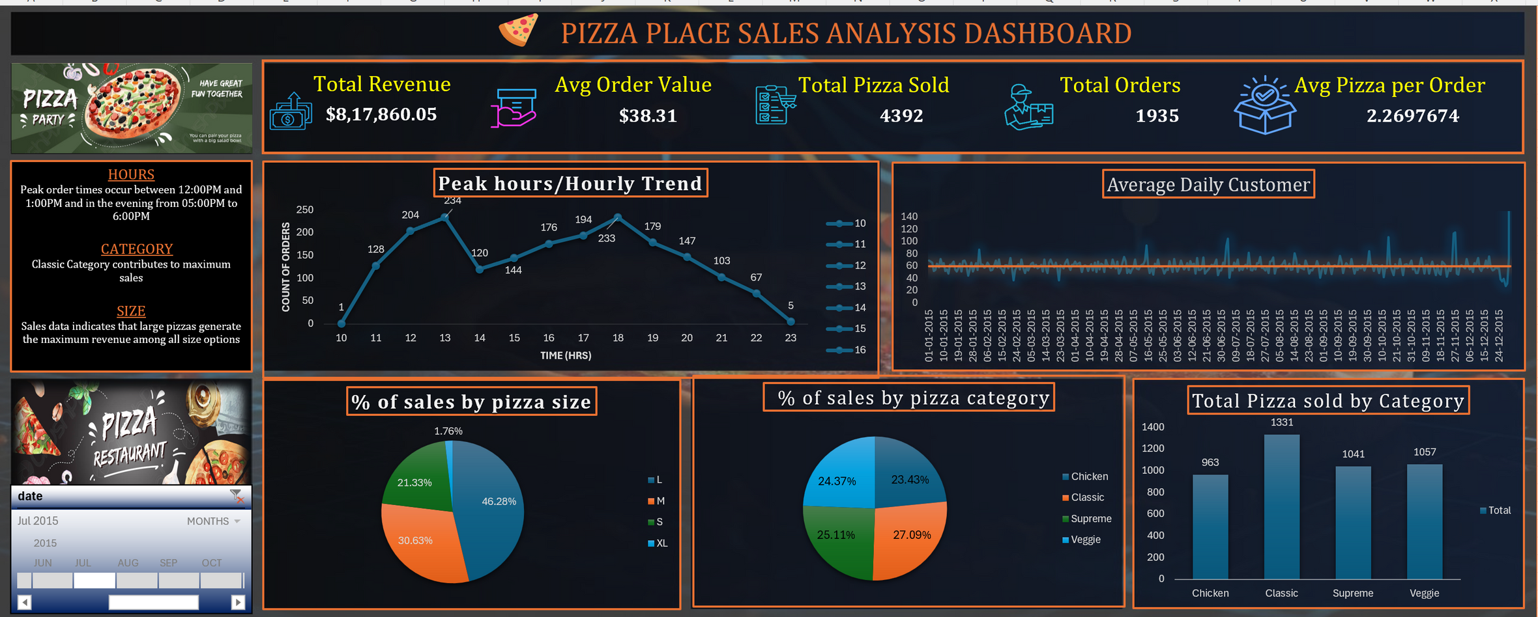
DASHBOARD 1
4

Slide 5
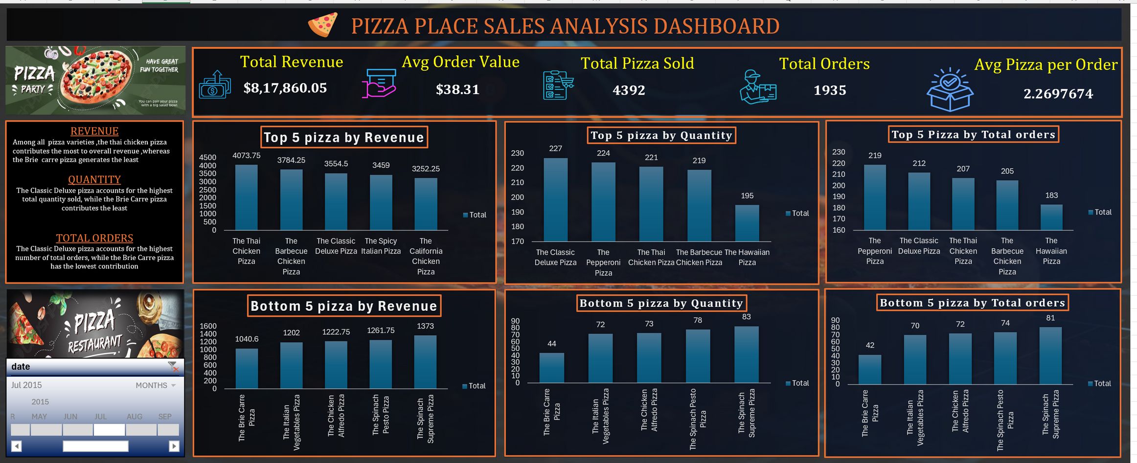
DASHBOARD 2
5

Slide 6
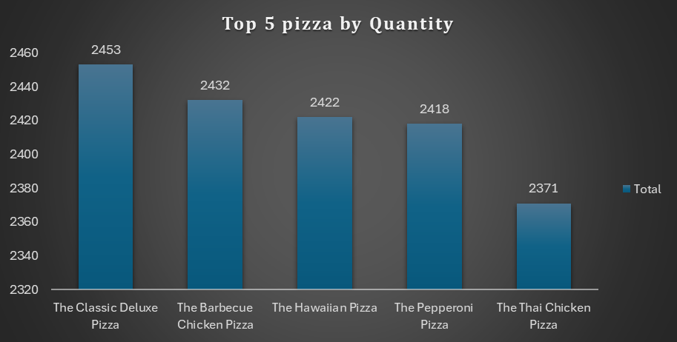
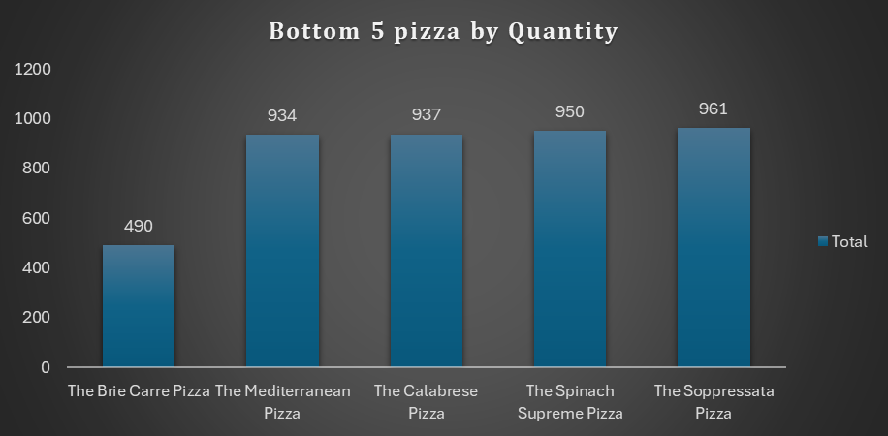
PRODUCT- LEVEL INSIGHTS
Top 5 Best-Selling Pizzas
The Classic Deluxe Pizza leads in sales volume, indicating high customer preference.
These pizzas consistently perform well across various sizes and time periods.
Bottom 5 Least-Selling Pizzas
The Brie Carre Pizza recorded the lowest quantity sold, suggesting low demand or that it only appeals to a small group of customers.
Other underperforming options include specialty or less familiar pizzas with unique toppings.
These items may require marketing focus or menu reconsideration.
6

Slide 7
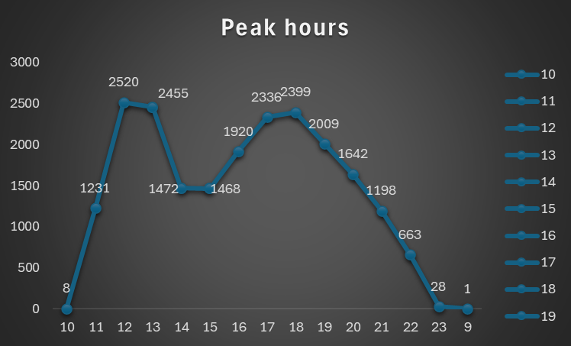
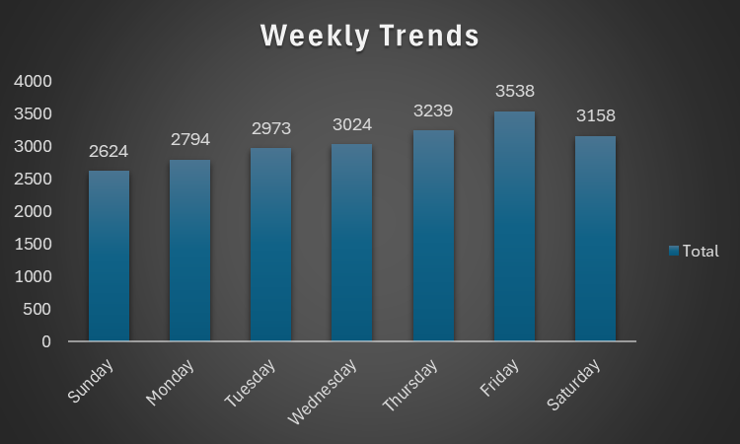
TIME-BASED ANALYSIS
Peak Hours:
The highest sales activity occurs during two distinct time windows: 12:00 PM to 1:00 PM and 5:00 PM to 6:00 PM. These peak periods suggest increased customer engagement during lunchtime and early evening, likely aligning with meal times or end-of-day purchases.
Weekly Trends:
Analysis of the weekly sales patterns reveals that Friday consistently records the highest sales compared to other days of the week. This may indicate increased consumer activity heading into the weekend.
7

Slide 8
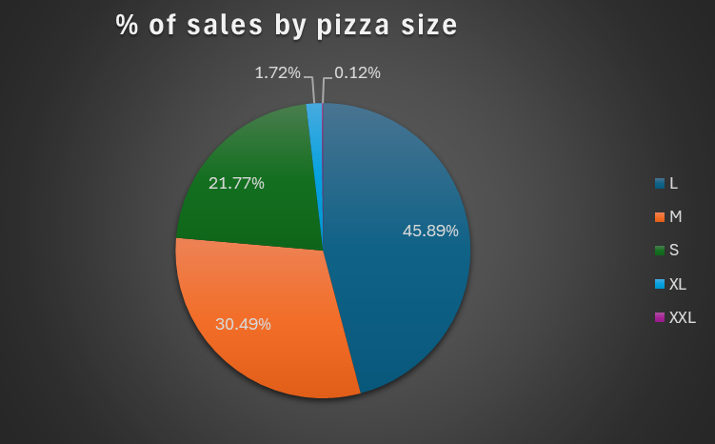
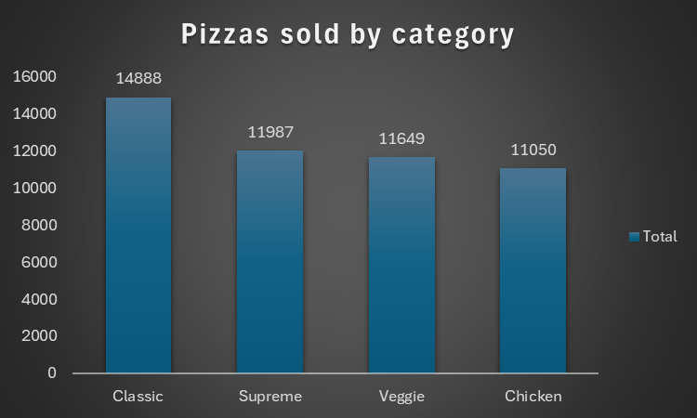
CUSTOMER & ORDER BEHAVIOUR
📏 Size Preferences
Large (L) and Medium (M) pizzas are the top choices across most orders.
XXL and XL sizes are less popular, possibly due to price or portion mismatch.
🍽️ Category Preferences
Classic pizzas are the best-selling category.
Followed by Supreme and Veggie categories.
Chicken have a smaller customer base.
8

Slide 9
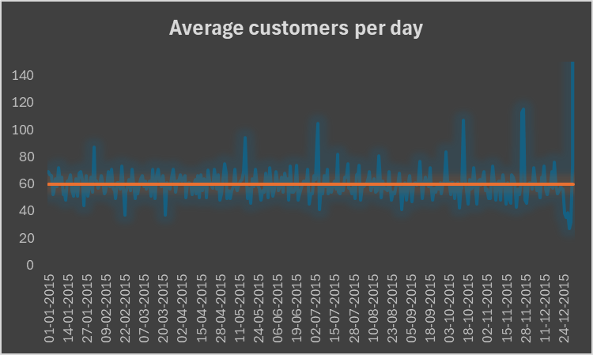
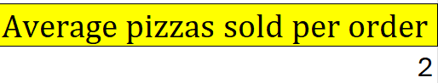
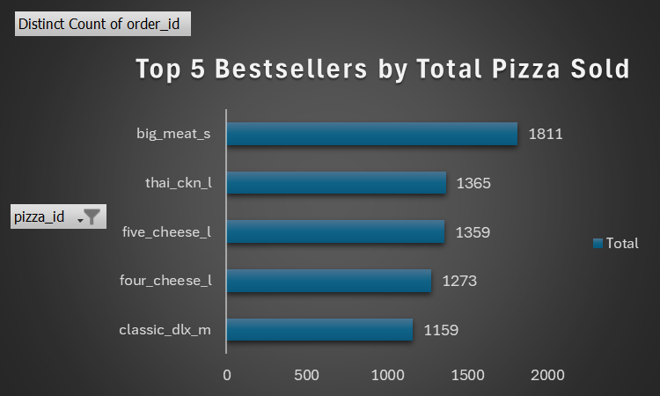
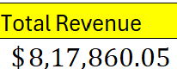
RECOMMENDED ANALYSIS
1. Find out how many customers do we have each day?
A) On an average we have 60 customers per day.
2.How many pizzas are typically in an order? Do we have any bestsellers?
A)
We have 2 pizza are typically in an order and big_meat_s is the bestseller
3)How much revenue did we generate this year?
9

Slide 10
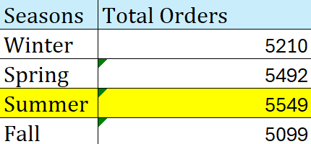
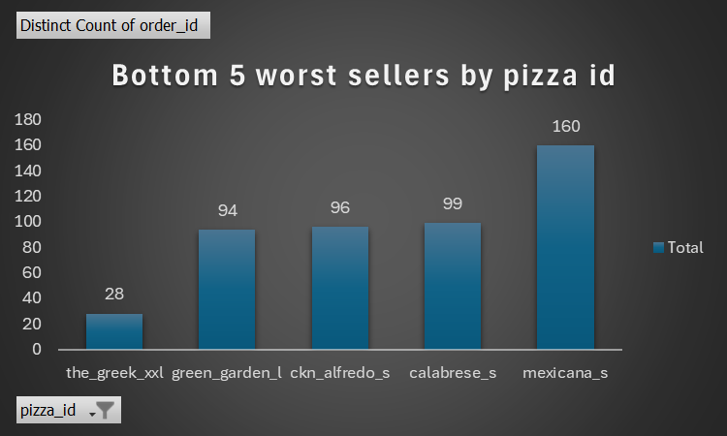
RECOMMENDED ANALYSIS
4) Can we identify any seasonal trends in the sales?
A) Spring & Summer Season has the maximum sale as compared to others seasons.
5) Are there any pizzas we should take off the menu, or any promotions we could leverage
A) We can take off the pizza from the menu is : the_greek_xxl
Since pizza sales are lowest during the fall season, introducing seasonal discounts or special promotions could help boost sales during this period.
Run special promotions on Fridays (e.g., "Friday Pizza Fiesta" deals) to maximize already high traffic.
Offer combo deals or happy hour offers on slower days like Sunday to boost weekend sales.
10

Slide 11
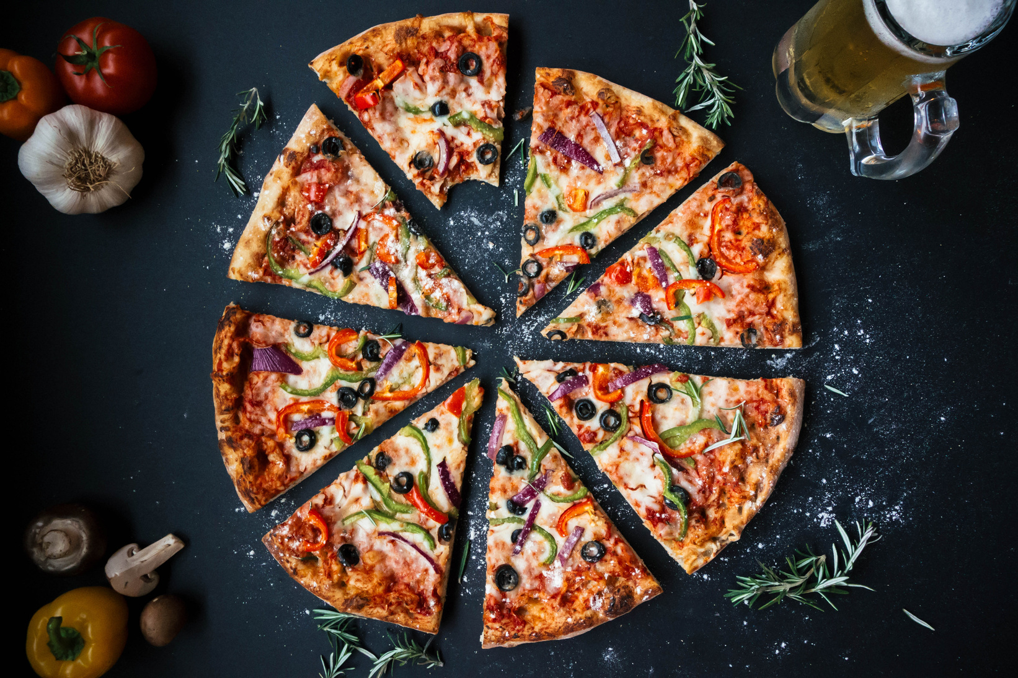
CONCLUSION
📅 Sales are highest on Fridays and during the summer months, showing strong customer demand at the end of the week and in warm seasons.
🍕 Large and Medium pizzas are the most preferred sizes, making them crucial for promotions and combo deals.
💰 Thai Chicken, BBQ Chicken, and Classic Deluxe pizzas are the top revenue-generating products.
❌ Brie Carre, Greek, and Italian Supreme pizzas consistently show low sales, suggesting they need menu improvements or better marketing.
🍂 Fall season records the lowest sales; launching seasonal discounts could help boost sales during this slow period.
🏆 Classic category has the highest sales, followed by Supreme and Veggie categories.
11

Slide 12
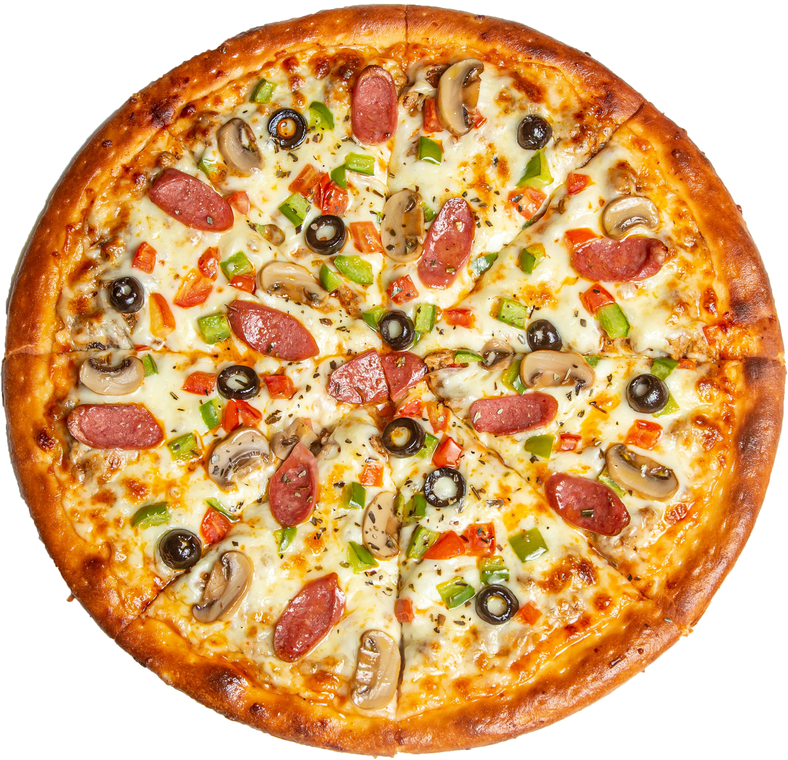
THANK YOU!

